Slide 1
Health Literacy & Plain Language Training

Slide 2
NPIN Overview
Funded by the U.S. Centers for Disease Control and Prevention (CDC), NPIN is a key resource for public health professionals.
NPIN serves as a comprehensive hub for those addressing HIV, TB, STIs, and viral hepatitis in their communities.
Discover more about NPIN at npin.cdc.gov.

Slide 3
Before We Start…
This webinar will be recorded.
The recording and slide deck that accompanies the presentation will be published to the NPIN website shortly afterwards.
There will be time for questions and answers after the webinar. Please add any questions to the Q&A chat module in the webinar viewer.

Slide 4



Introduction
Pearl Owen
Managing Director
Strategic Planning
Dino Hainline
Senior Strategist
Strategic Planning

Slide 5





Goals For Today
    Understand the real-world implications
    of not considering limited health literacy
    Learn who is most affected by
    limited health literacy
    Understand the relationship between literacy and health literacy
    Dive into health literacy best practices
    Learn what resources are available to help create materials using health literacy best practices

Slide 6
Who Is This Course For? Everyone
Geared toward someone creating
communication materials for the public
(brochures, fact sheets, landing pages, advertisements, etc.)
Less
experience
Deep
experience
We acknowledge that some of you may have more or less experience in this topic and hope that this information is either a reminder/refresher tutorial that compliments your expertise or a good foundation for continued learning.

Slide 7
“A two-year-old is diagnosed with an inner ear infection and prescribed an antibiotic. Her mother understands that her daughter should take the prescribed medication twice a day. After carefully studying the label on the bottle and deciding that
it doesn’t tell how to take the medicine, she fills
a teaspoon and pours the antibiotic into her daughter’s painful ear.”
National Academies of Sciences, Engineering, and Medicine. 2004. Health Literacy: A Prescription to End Confusion. Washington, DC: The National Academies Press
Notes:
https://nap.nationalacademies.org/download/10883#

Slide 8
What Is Health Literacy?
There are two paths to consider
when addressing health literacy:
Personal health literacy is the degree to which individuals have the ability to find, understand, and use information and services to inform health-related decisions and actions for themselves and others.
Organizational health literacy is the degree to which organizations equitably enable individuals to find, understand, and use information and services to inform health-related decisions and actions for themselves and others.
Link: https://www.cdc.gov/health-literacy/php/about/
An important tool which we will discuss later in the presentation that organizations can use to improve organizational health literacy is the concept of Plain Language. Plain Language makes it easier for everyone to understand and use health information. Although Plain Language is a familiar idea, many organizations don’t use it as often as they should.
Link: https://www.cdc.gov/health-literacy/php/develop-materials/plain-language.html

Slide 9
Health Literacy Affects Everyone
Even people who read well and are comfortable using numbers can face health literacy issues when
They aren’t familiar with medical terms or how their bodies work.
They must interpret statistics and evaluate risks and benefits that affect their health and safety.
They are diagnosed with a serious illness and are scared and confused.
They have health conditions that require complicated self-care.
They are voting on an issue affecting the community’s health and relying on unfamiliar technical information.
*https://health.gov/sites/default/files/2019-09/Health_Lit_Action_Plan_Summary.pdf
Notes:
Health literacy is important for everyone because, at some point in our lives, we all need to be able to find, understand, and use health information and services.
Taking care of our health is part of everyday life, not just when we visit a doctor, clinic, or hospital. Health literacy can help us prevent health problems, protect our health, and better manage health problems when they arise.
https://www.cdc.gov/healthliteracy/learn/Understanding.html#HowCanWeHelpPeopleNow
https://health.gov/sites/default/files/2019-09/Health_Lit_Action_Plan_Summary.pdf

Slide 10
The "Silent Epidemic"
“Health for all Americans starts with health literacy. Half of U.S. adults have limited literacy skills and up to 9 in 10 are not proficient in health literacy. All sectors of health — from public health to health care delivery to health policy — need to commit to meeting people where they are with health information that is easy to understand.”
(Brett P. Giroir, M.D., former U.S. Assistant Secretary for Health, December 19, 2019)
Notes:
Older Quote: National Academies of Sciences, Engineering, and Medicine. 2004. Health Literacy: A Prescription to End Confusion. Washington, DC: The National Academies Press. https://doi.org/10.17226/10883.

Slide 11
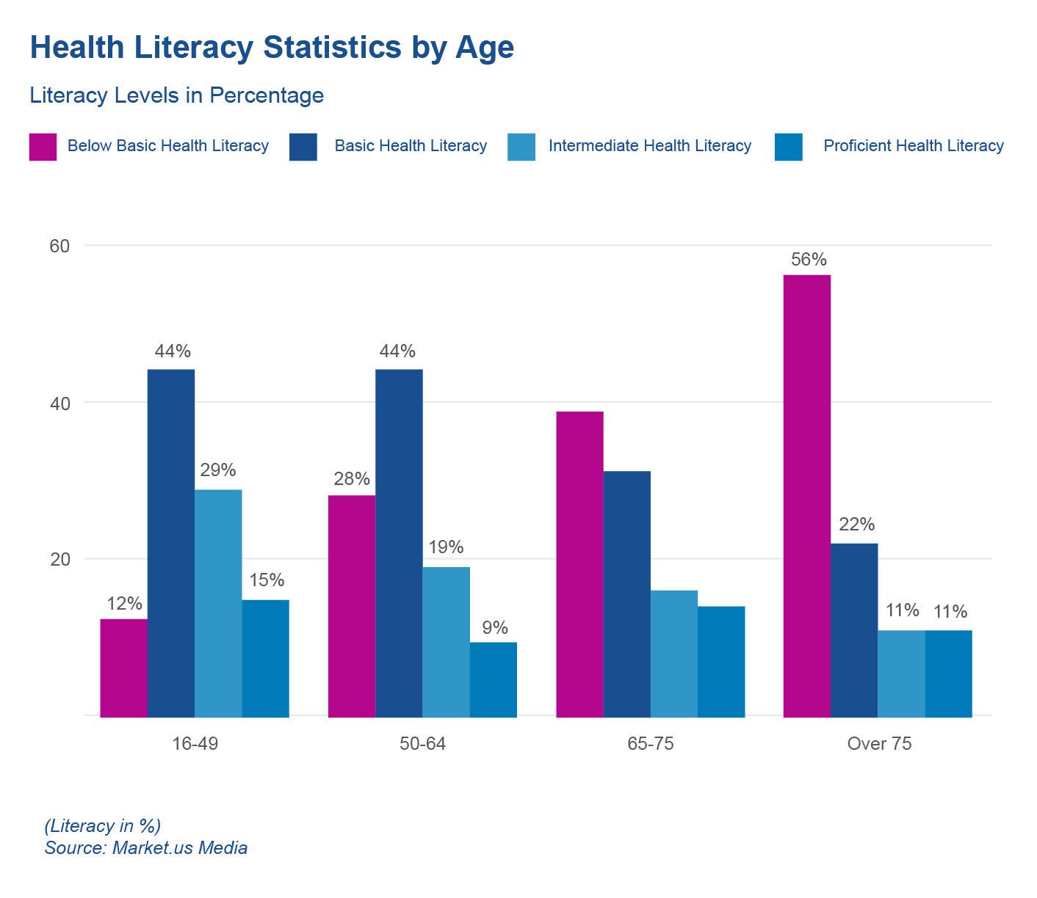
As People Age, They Are More Likely To Have Below Basic Health Literacy (2024)
39%
31%
16%
14%
Notes:
https://media.market.us/health-literacy-statistics/
https://www.cdc.gov/healthliteracy/learn/Understanding.html#HowCanWeHelpPeopleNow
https://health.gov/sites/default/files/2019-09/Health_Lit_Action_Plan_Summary.pdf

Slide 12
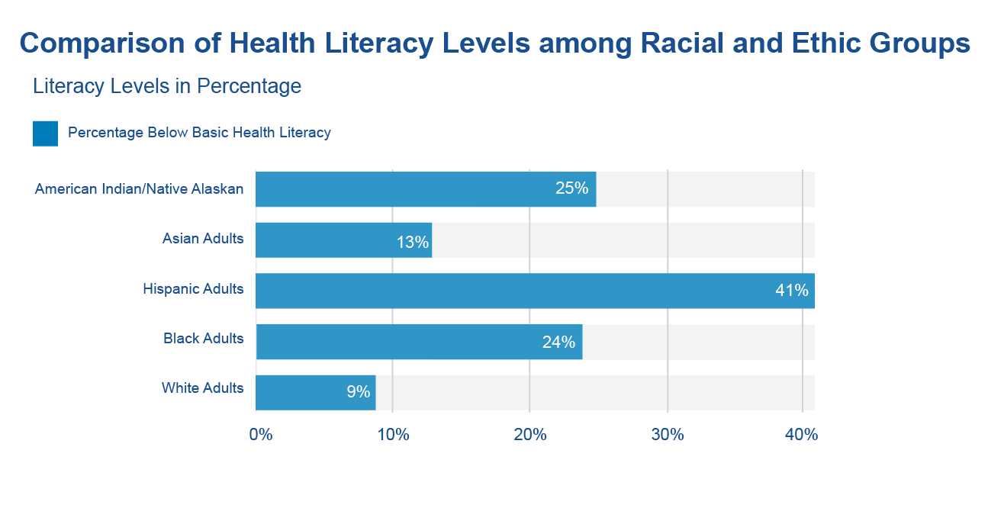
Higher Percentages of Hispanic, American Indian/Native Alaskan, and Black Adults Have Below Basic Health Literacy
Notes:
https://media.market.us/health-literacy-statistics/
https://www.cdc.gov/healthliteracy/learn/Understanding.html#HowCanWeHelpPeopleNow
https://health.gov/sites/default/files/2019-09/Health_Lit_Action_Plan_Summary.pdf

Slide 13
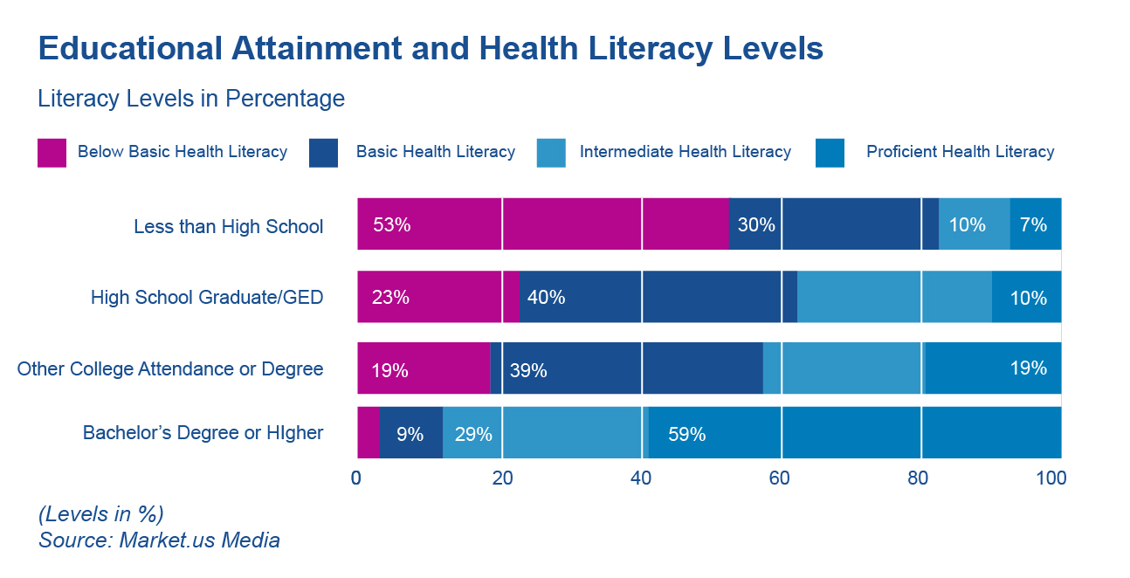
Health Literacy by Education – 2024 Statistics
Notes:
https://media.market.us/health-literacy-statistics/
https://www.cdc.gov/healthliteracy/learn/Understanding.html#HowCanWeHelpPeopleNow
https://health.gov/sites/default/files/2019-09/Health_Lit_Action_Plan_Summary.pdf

Slide 14
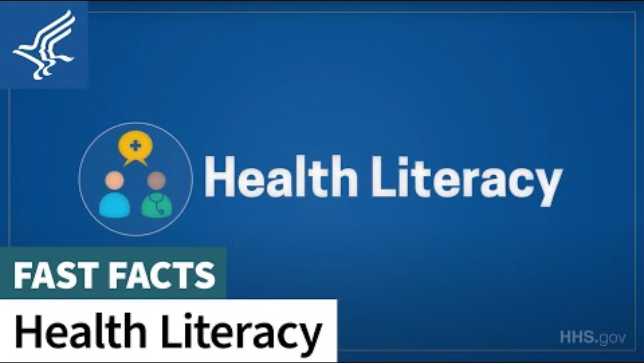
Five Things to Know About Health Literacy
Notes:
https://youtu.be/BG-iY-em7mk?si=jNep5o5e6k_6IiXr

Slide 15
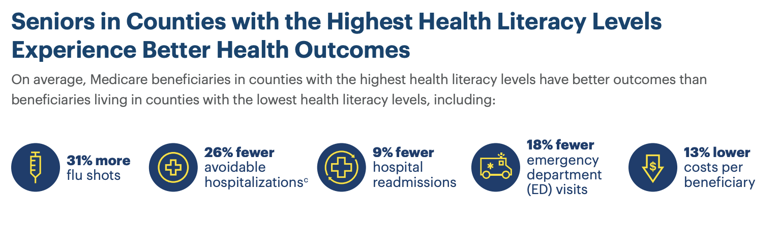
Impacts of Limited Health Literacy – Senior Health Outcomes
Notes:
https://www.cdc.gov/healthliteracy/learn/Understanding.html#HowCanWeHelpPeopleNow

Slide 16
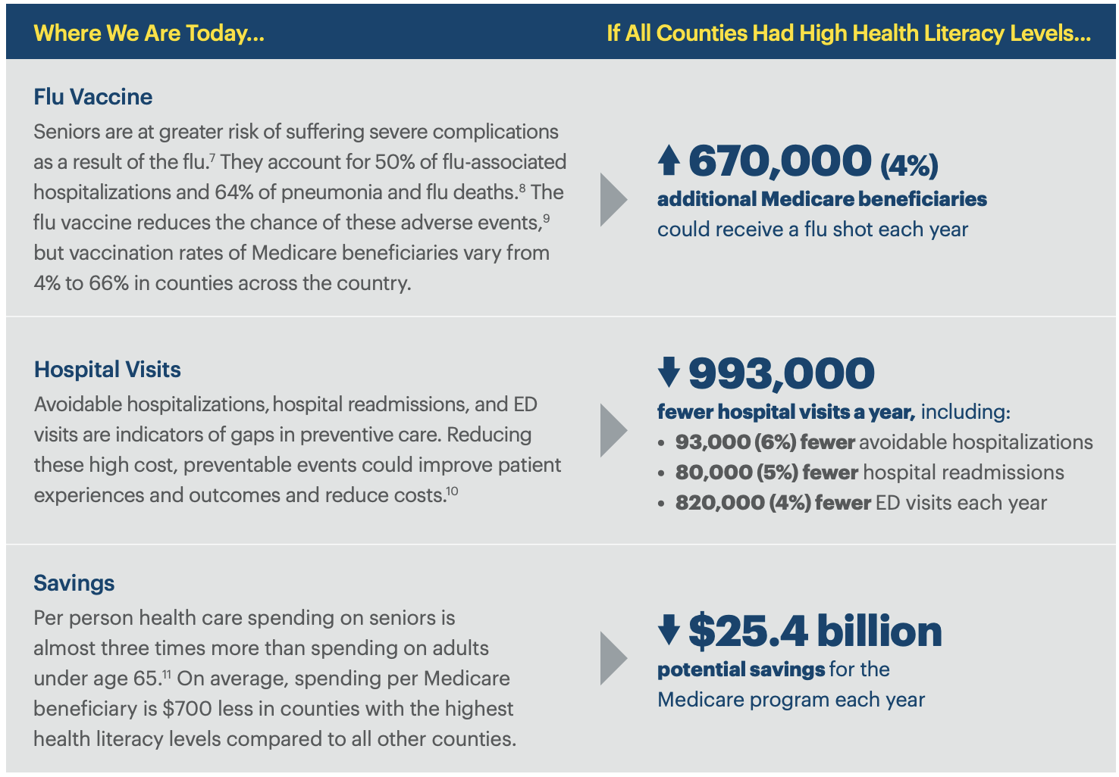
Impacts of Limited Health Literacy – Senior Benefits and Government Savings
Notes:
https://www.cdc.gov/healthliteracy/learn/Understanding.html#HowCanWeHelpPeopleNow

Slide 17
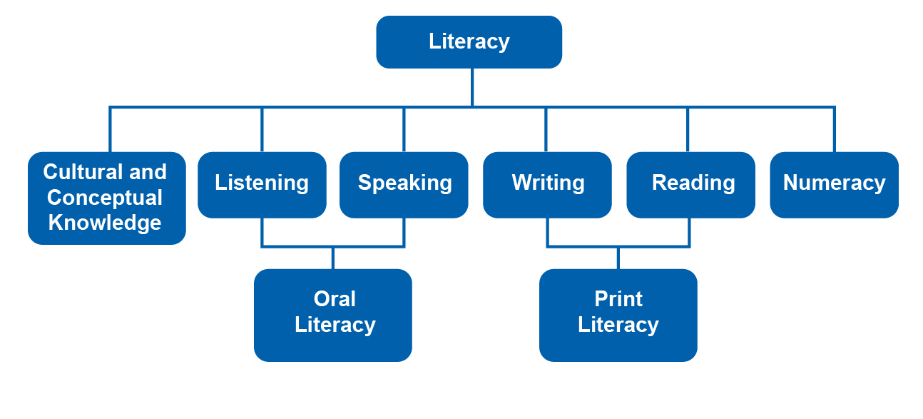
Are Limited Health Literacy and Limited Literacy the Same Problem?
Limited health literacy and limited literacy are not the same, but they are related. Strong literacy and numeracy skills do help people understand and use health information and services, but research shows that most people still say that information and services are unfamiliar, complicated, and too technical.
Notes:
https://www.cdc.gov/healthliteracy/learn/Understanding.html#HowCanWeHelpPeopleNow
https://nap.nationalacademies.org/download/10883#

Slide 18
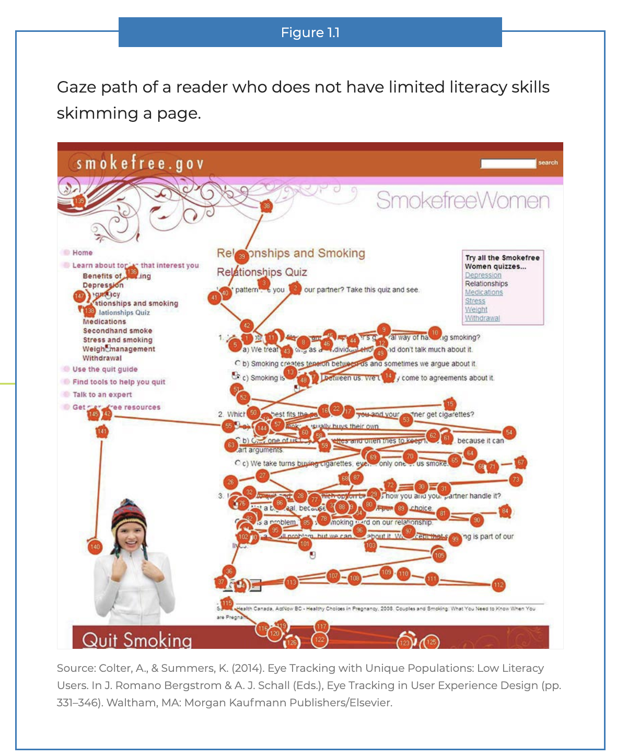
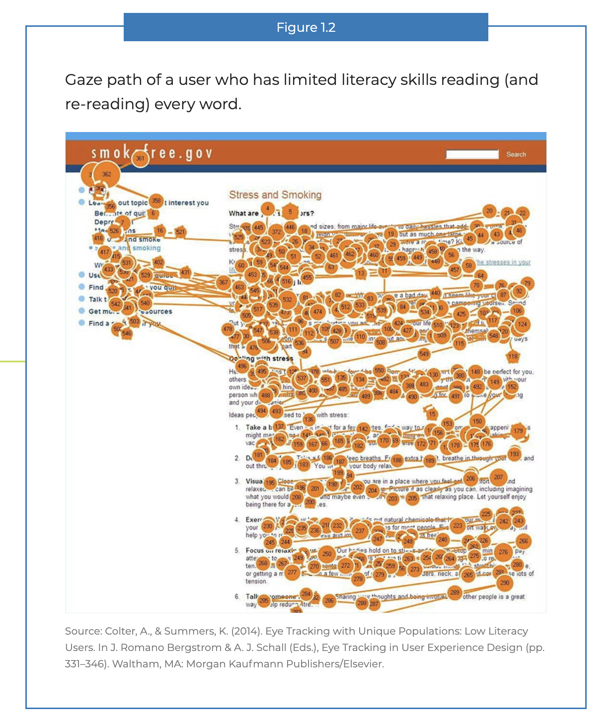
Low Health Literacy Leads to Increased Frustration
Notes:
https://health.gov/healthliteracyonline/what-we-know/section-1-1/

Slide 19
Health Literacy Is the Difference Between Life and Death
“A 29-year-old African-American woman with three days of abdominal pain and fever was brought to a Baltimore emergency department by her family. After a brief evaluation she was told that she would need an exploratory laparotomy. She subsequently became agitated and demanded to have her family take her home. When approached by staff, she yelled “I came here in pain and all you want is to do is an exploratory on me! You will not make me a guinea pig!” She refused to consent to any procedures and later died of appendicitis.”
National Academies of Sciences, Engineering, and Medicine. 2004. Health Literacy: A Prescription to End Confusion. Washington, DC: The National Academies Press
Notes:
https://nap.nationalacademies.org/download/10883#

Slide 20

Health Literacy Best Practices:
High Level Overview of Foundational Resources, Tools, and Guides

Slide 21

Clear Communication Framework
Cultural Competency
Health Literacy
Accessibility
The Root System Unites These Disciplines

Slide 22

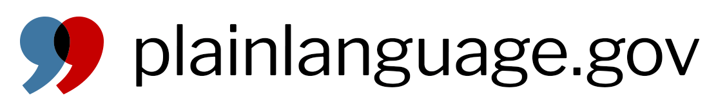
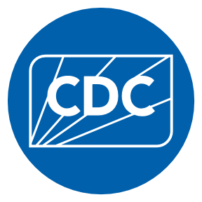
Health Literacy: High Level Overview
11
8
Reviewing, editing and testing your communication
Creating your communication
Federal Plain Language Guidelines
Everyday Words
7
Understanding Your Audience
10
6
The Three A's
Clear Writing Assessment
5
9
4
Clear Communication Index
Training Courses
CDC Health Literacy Website
Foundational documents and resources
3
CDC Health Literay Action Plan
2
Healthy People 2010, 2020, 2030 continue to evolve definitions
1
National Action Plan To Improve Health Literacy (2010)
Notes:
Visual is meant to help orient everyone about what our foundational "source" documents vs "guide" documents that help you create your writing and "tool" documents that help you assess your writing.
The trunk: foundational documents that lay the foundation or fundamentals of health literacy (both from the HHS and the CDC).
Left branches: instructive sources that guide you on your writing
Right branches: user-friendly sources that help you assess your writing once complete
It's important to have "spatial awareness" of source documents that capture the breadth and depth of the issues as well as how to navigate the guides for writing and the tools for assessing writing.

Slide 23
High Level Overview
11
8
Reviewing, editing and testing your communication
Creating your communication
Federal Plain Language Guidelines
Everyday Words
7
Understanding Your Audience
10
6
The Three A's
Clear Writing Assessment
5
9
4
Clear Communication Index
Training Courses
CDC Health Literacy Website
Foundational documents and resources
3
CDC Health Literay Action Plan
2
Healthy People 2010, 2020, 2030 continue to evolve definitions
1
National Action Plan To Improve Health Literacy (2010)

Slide 24
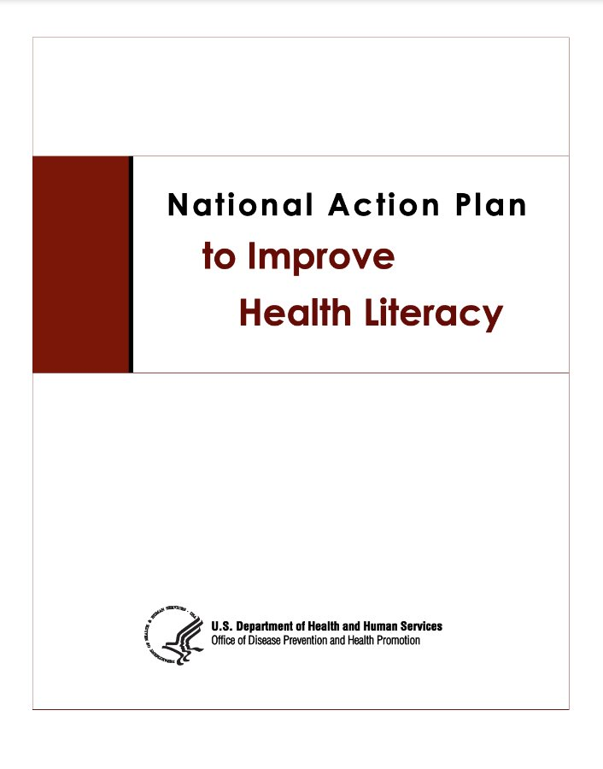
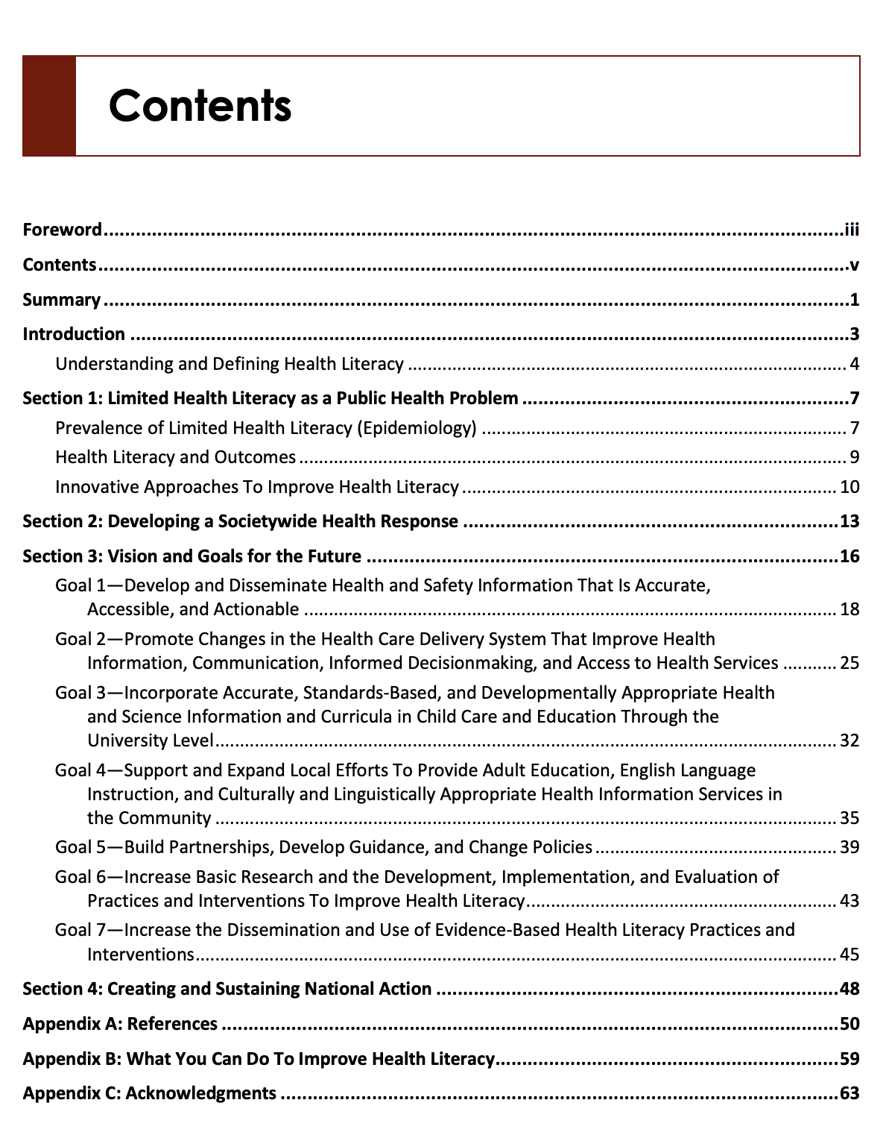
National Action Plan to Improve Health Literacy (2010)
1
"The National Action Plan to Improve Health
Literacy envisions a restructuring of the
ways we create and disseminate all types
of health information in this country."
Foundational plan that documents prevalence,
outcomes and goals for the future.
References Healthy People 2010 and 2020.
Link: https://health.gov/sites/default/files/2019-09/Health_Literacy_Action_Plan.pdf

Slide 25



Healthy People 2010, 2020, 2030
2
Foundational principal (2030): Achieving health and well-being requires eliminating
health disparities, achieving health equity, and attaining health literacy.
Overarching goal (2030): Eliminate health disparities, achieve health equity, and attain health literacy to improve the health and well-being of all.
Definitions (2030):
Personal health literacy is the degree to which individuals can find, understand,
and use information and services to inform health-related decisions and actions
for themselves and others.
Organizational health literacy is the degree to which organizations equitably enable individuals to find, understand, and use information and services to inform health-related decisions and actions for themselves and others.
The new 2030 definitions:
Emphasize people’s ability to use health information rather than just understand it
Focus on the ability to make “well-informed” decisions rather than “appropriate” ones
Acknowledge that organizations have a responsibility to address health literacy
Incorporate a public health perspective
Link: https://health.gov/healthypeople/priority-areas/health-literacy-healthy-people-2030
Notes:
https://www.cdc.gov/healthliteracy/learn/index.html#wnd

Slide 26
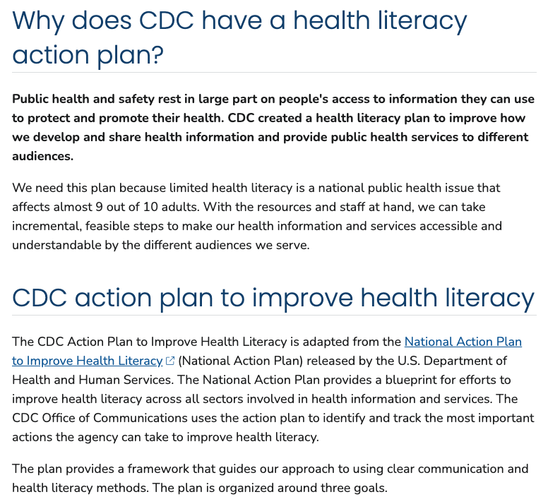
CDC's Health Literacy Action Plan
3
Goal 1: Develop and Share Health and Safety Information That Is Accurate, Accessible, and Actionable
Goal 2: Integrate Clear Communication and Health Literacy into Public Health Planning, Funding, Policy Development, Research, and Evaluation
Goal 3: Incorporate Accurate, Standards-Based, and Developmentally Appropriate Health and Science Information and Curricula in Educational Settings from Preschool through University Levels
Link: https://www.cdc.gov/health-literacy/php/develop-plan/cdc-plan.html
Notes:
https://www.cdc.gov/healthliteracy/PlanAct/cdcplan.html#anchor_1617804225193

Slide 27
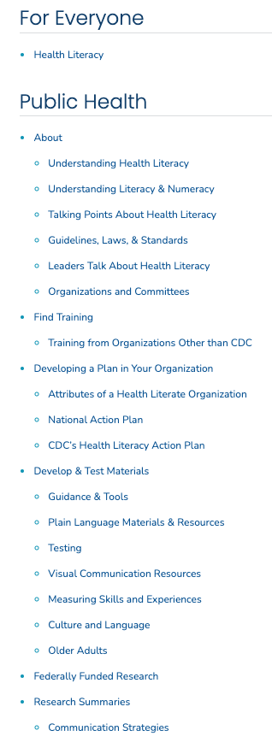
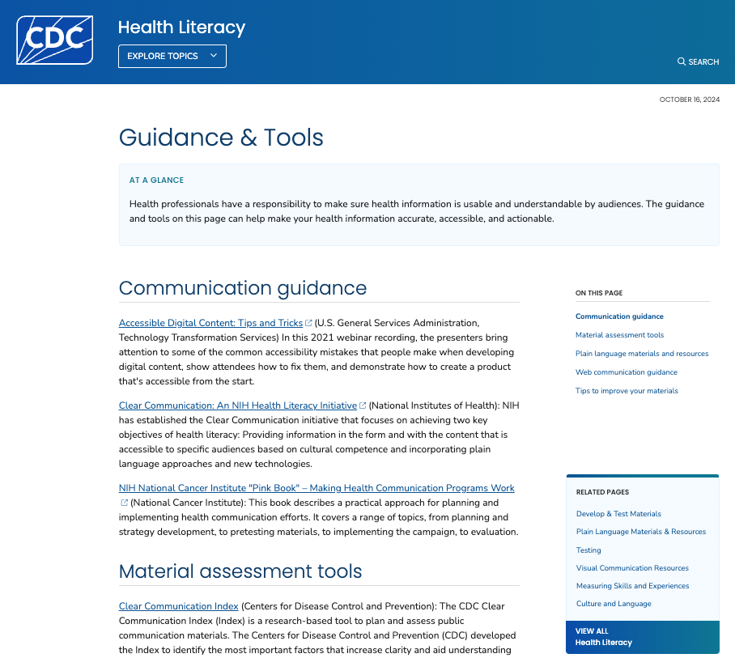
CDC Health Literacy Website: Overview
4
Detailed navigation bar with drop down menu
Link: https://www.cdc.gov/health-literacy/php/develop-materials/guidance-standards.html
Notes:
https://www.cdc.gov/health-literacy/

Slide 28
High Level Overview
11
8
Reviewing, editing and testing your communication
Creating your communication
Federal Plain Language Guidelines
Everyday Words
7
Understanding Your Audience
10
6
The Three A's
Clear Writing Assessment
5
9
4
Clear Communication Index
Training Courses
CDC Health Literacy Website
Foundational documents and resources
3
CDC Health Literay Action Plan
2
Healthy People 2010, 2020, 2030 continue to evolve definitions
1
National Action Plan To Improve Health Literacy (2010)

Slide 29
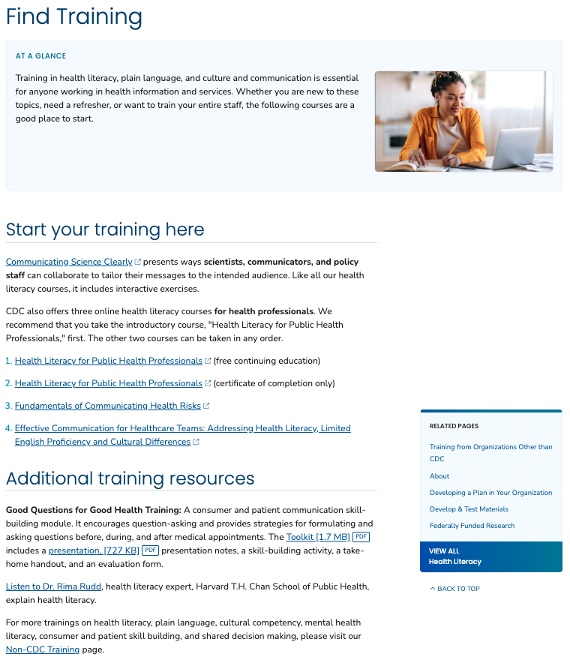
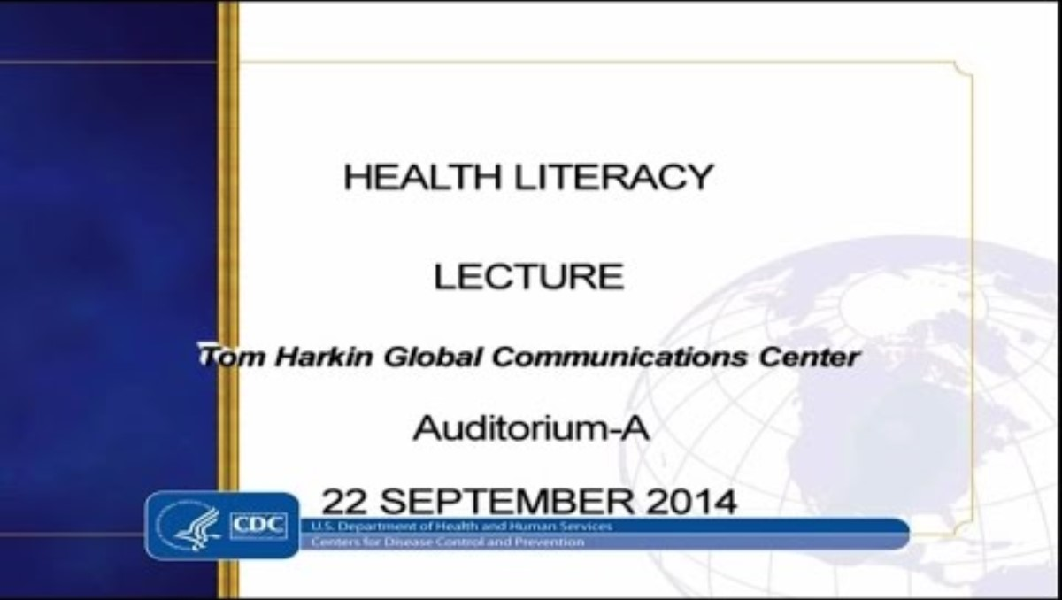
CDC Health Literacy Website: Training Courses
5
Dr. Rima Rudd, health literacy expert, Harvard T.H. Chan School of Public Health, explains health literacy.
Link: https://www.youtube.com/watch?v=4N8QxVkjHRY&t=1s
Link: https://www.cdc.gov/health-literacy/php/find-training/get-training.html
Notes:
https://www.cdc.gov/healthliteracy/gettraining.html

Slide 30
CDC Literacy Website: The Three A's
6
Health information should be:
Accurate: Using health literacy best practices does not mean “dumbing-down” the information or distorting the science. Health literacy practices make sure information is presented accurately AND in ways that people can understand.
Accessible: Just because you create health information doesn’t mean people see it or can use it.
Where and how you present your information affects its accessibility. Key aspects to consider:
  Is the information where people can see it?
  How will people who aren’t actively looking for your information be exposed to it?
  Do you have a main message statement?
  Have you made the information easy to skim and scan with large font, sub-heads and bullets, and white space?
  Do the images match the text and have useful captions?
  Even in the digital age, where posting information on the Web is easy and low-cost, the Web is not always the best way to reach “the general public.” Multiple channels and formats are best, and it is your responsibility to ensure the information you created reaches the public in a usable format.
Actionable: It is human nature to want to tell people all we know about something, but that doesn’t necessarily help. In the health field, we typically want people to start or stop doing something or do more or less of something. However, we often spend our resources giving people background information instead of our recommendations. Some background information may be important, but make sure you provide actionable information so the people you want to reach CAN do something with the information provided.
Link: https://www.cdc.gov/health-literacy/php/develop-materials/develop-test-materials.html
Notes:
https://www.cdc.gov/healthliteracy/developmaterials/index.html

Slide 31
CDC Health Literacy Website:
Understand Your Audience
7
Understand your audience:
Their needs, wants, motivations, attitudes, and values
Their literacy, health literacy, and numeracy skills
Their cultural beliefs and practices
Their preferred communication channels
for getting health messages
You can often find this information by conducting a literature search, using an audience research database, consulting an organization that works directly with your intended audience, or by conducting a survey with a sample of your audience. The more you know about your audience, the better you can reach them with messages, activities, and policies. We’ve provided resources and tools to get you started
Link: https://archive.cdc.gov/www_cdc_gov/healthliteracy/developmaterials/understandaudience/index.html
Notes:
https://archive.cdc.gov/#/details?url=https://www.cdc.gov/healthliteracy/developmaterials/understandaudience/index.html

Slide 32
CDC Health Literacy Website:
Understand Your Audience
7
Adopting User-Centered Design:
Strong evidence supports involving members of the target audience in the design and testing of communication products. This participatory design process results in improved outcomes, including those for people with limited health literacy.
Link: https://health.gov/sites/default/files/2019-09/Health_Literacy_Action_Plan.pdf
Notes:
https://archive.cdc.gov/#/details?url=https://www.cdc.gov/healthliteracy/developmaterials/understandaudience/index.html

Slide 33
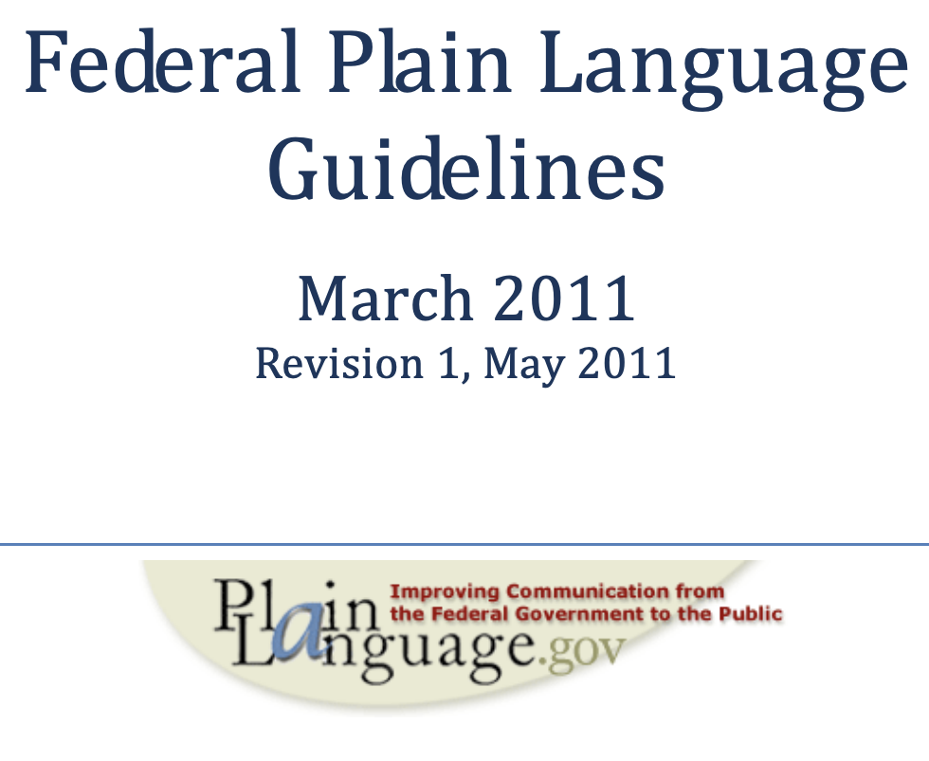
Plain Language: Best Practices
8
Think about your audience (write to one)
Organize (one-person, useful headings,
short sections)
Write your document
  Verbs (active, simple)
  Nouns and pronouns
  (speak directly, minimize abbreviations)
  Other word issues (short, simple)
Sentences (short, clear)
Paragraphs (topic sentences, transitions)
Other aids to clarity (examples lists, tables,
illustrations, highlight)
Write for the Web
Test (paragraph, usability, controlled comparative)
Link: https://www.plainlanguage.gov/media/FederalPLGuidelines.pdf
Notes:
https://www.plainlanguage.gov/media/FederalPLGuidelines.pdf

Slide 34





Plain Language: Highlights
8
Your Audience | Organize | Word Choice | Structure | Test
Think about your audience Write for your audience One audience at a time | Organize for your reader Short sections with useful headings | Use active voice Simplest form words Minimize abbreviations Speak directly to readers Avoid legal or technical jargon | Short sentences Structure paragraphs Use examples, lists, tables, illustrations Emphasize important concepts Design document for easy reading *More materials available for Web content | Test early and often (iterate) Paraphrase Testing Usability Testing (https://digital.gov/ topics/usability/) Controlled Comparative Studies
Notes:
https://www.plainlanguage.gov/media/FederalPLGuidelines.pdf

Slide 35
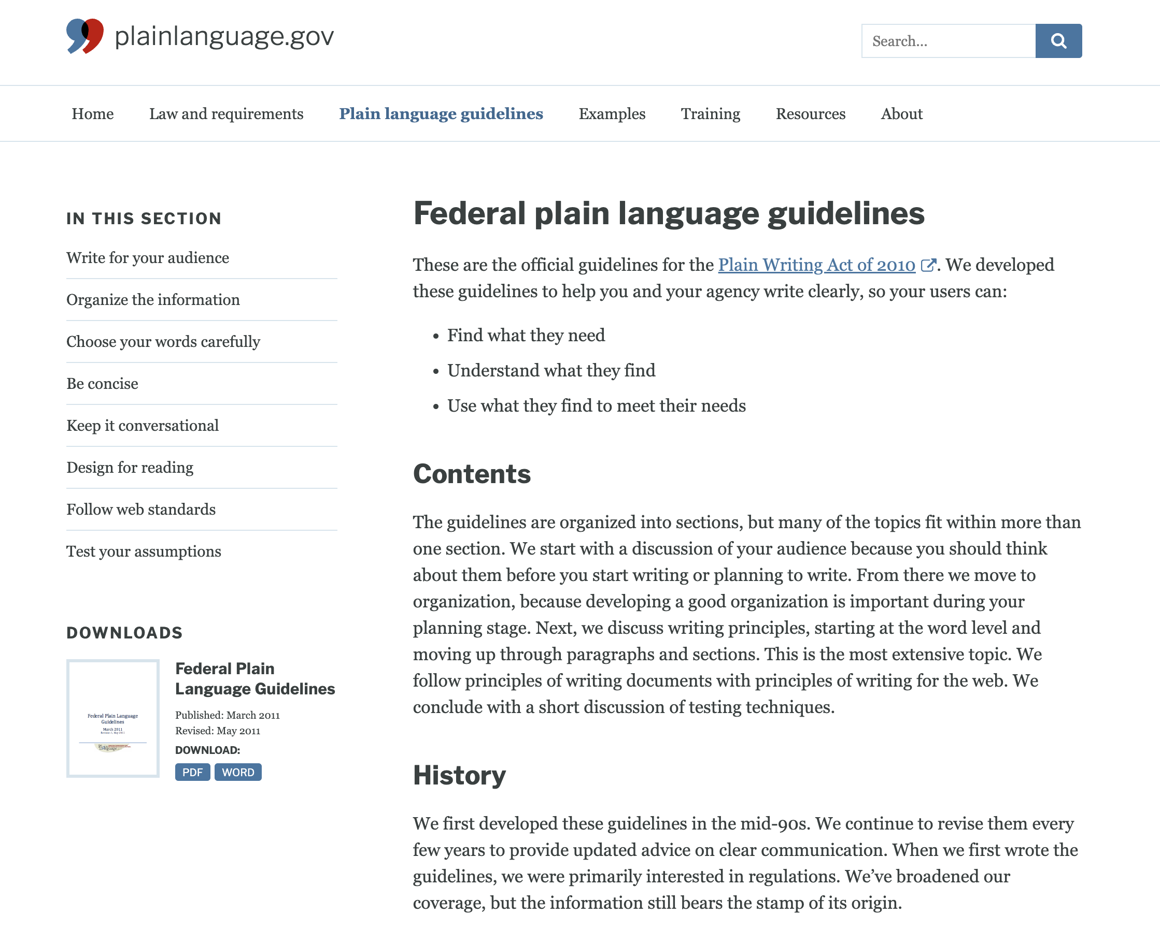
Plain Language: Website
8
Link: https://www.plainlanguage.gov/guidelines/
Notes:
https://www.plainlanguage.gov/guidelines/

Slide 36
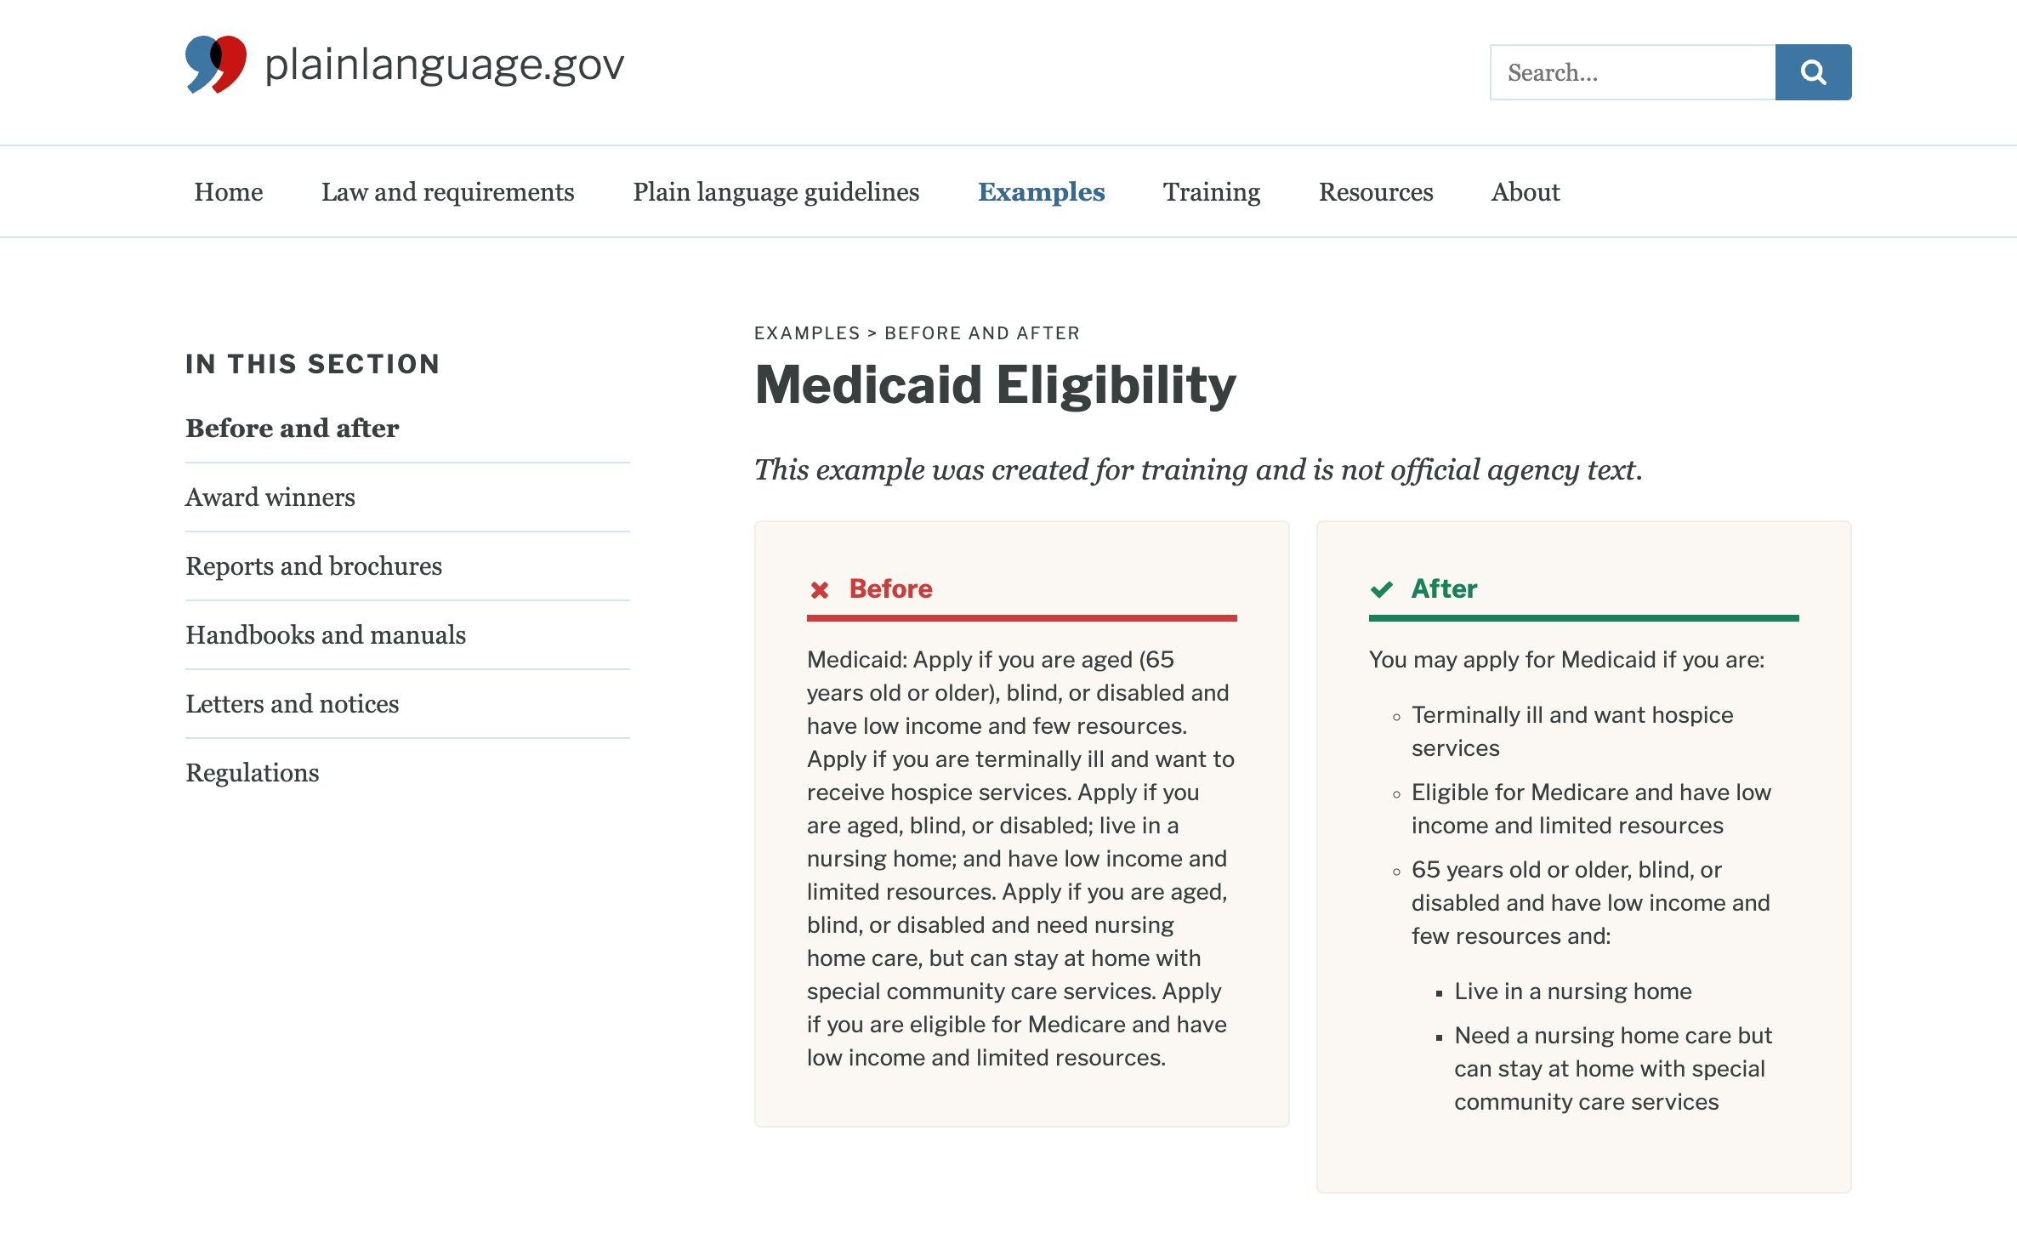
Plain Language: Examples
8
Link: https://www.plainlanguage.gov/examples/before-and-after/medicaid-eligibility/

Slide 37
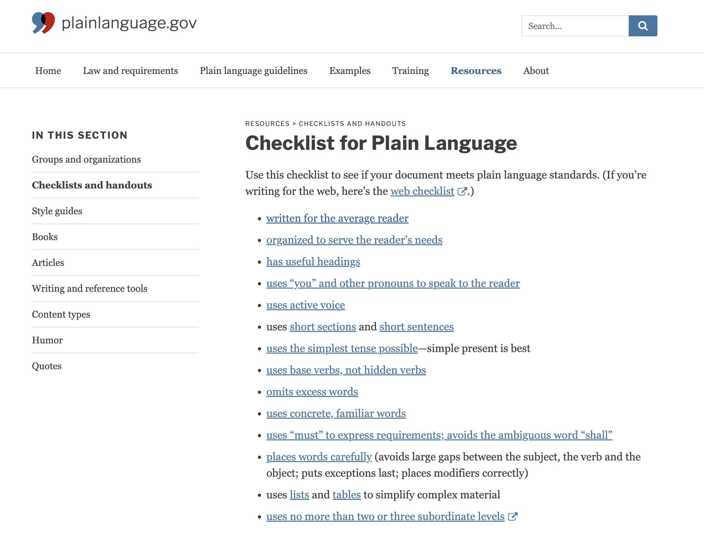
Plain Language: Checklist
8
Link: https://www.plainlanguage.gov/resources/checklists/checklist/

Slide 38
High Level Overview
11
8
Reviewing, editing and testing your communication
Creating your communication
Federal Plain Language Guidelines
Everyday Words
7
Understanding Your Audience
10
6
The Three A's
Clear Writing Assessment
5
9
4
Clear Communication Index
Training Courses
CDC Health Literacy Website
Foundational documents and resources
3
CDC Health Literay Action Plan
2
Healthy People 2010, 2020, 2030 continue to evolve definitions
1
National Action Plan To Improve Health Literacy (2010)

Slide 39
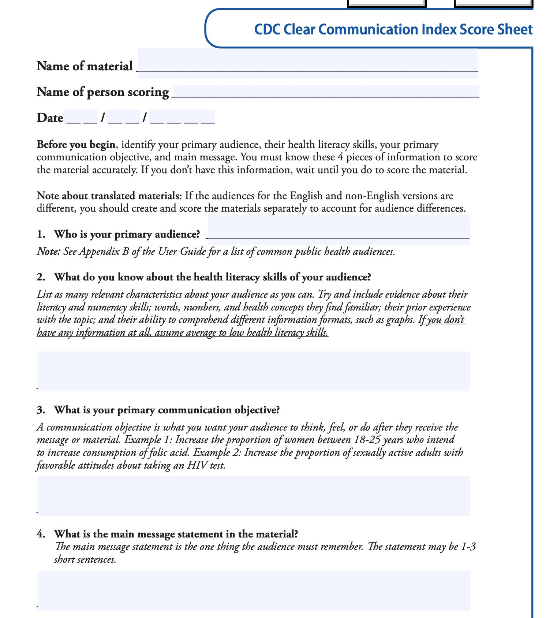
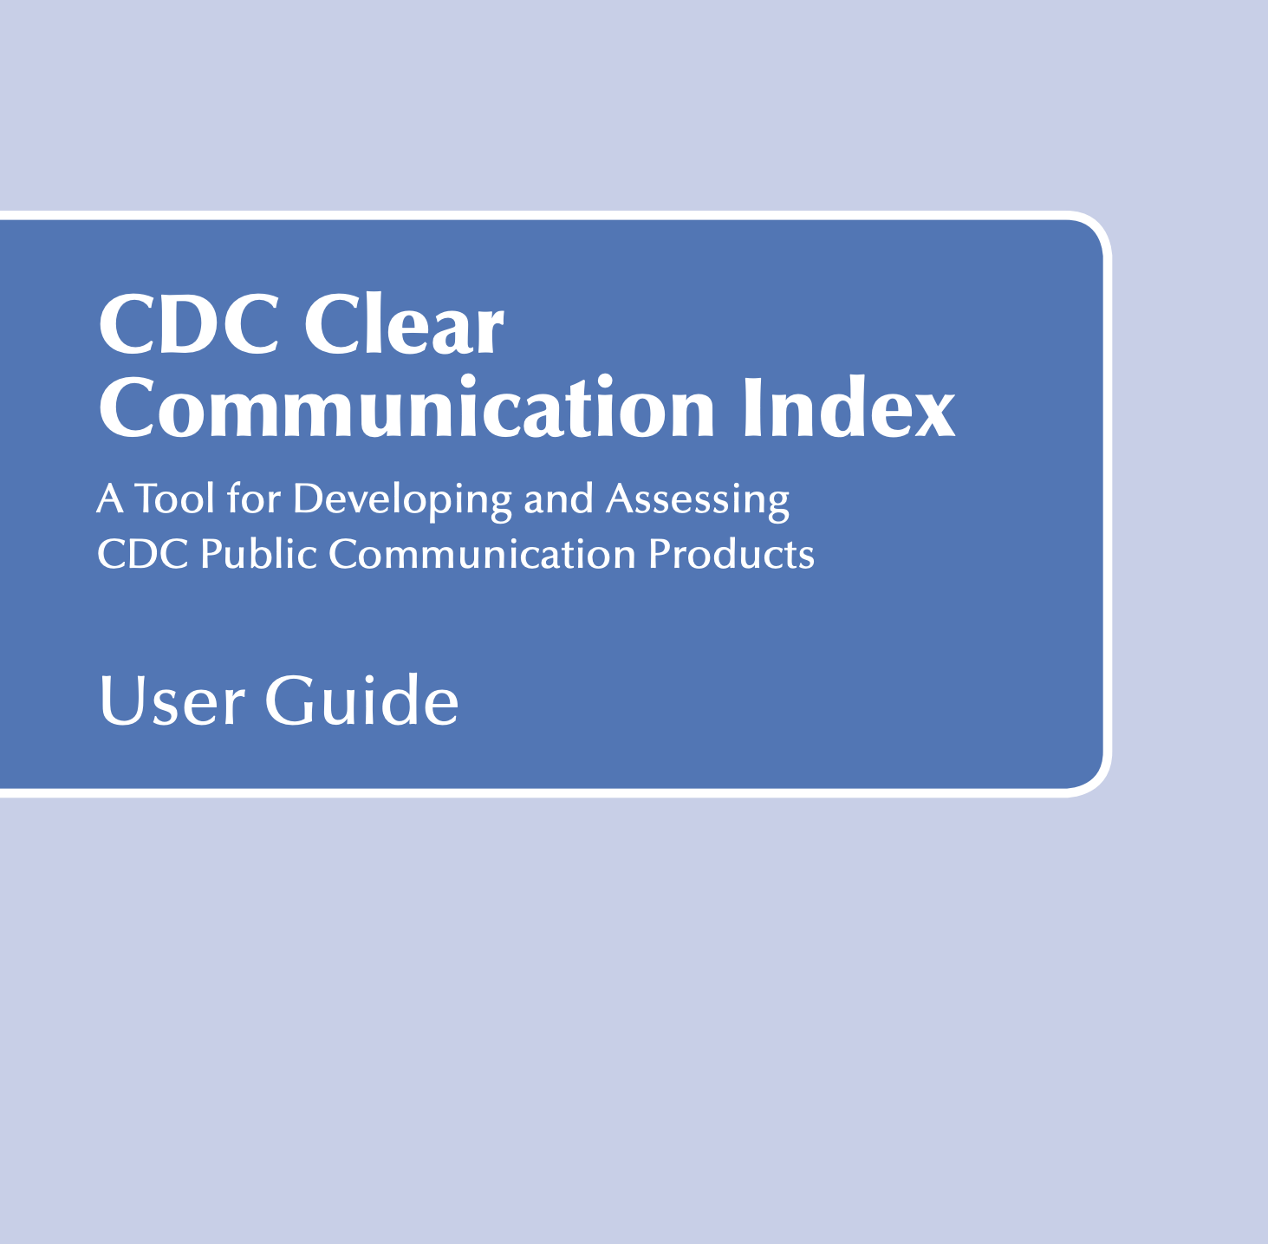
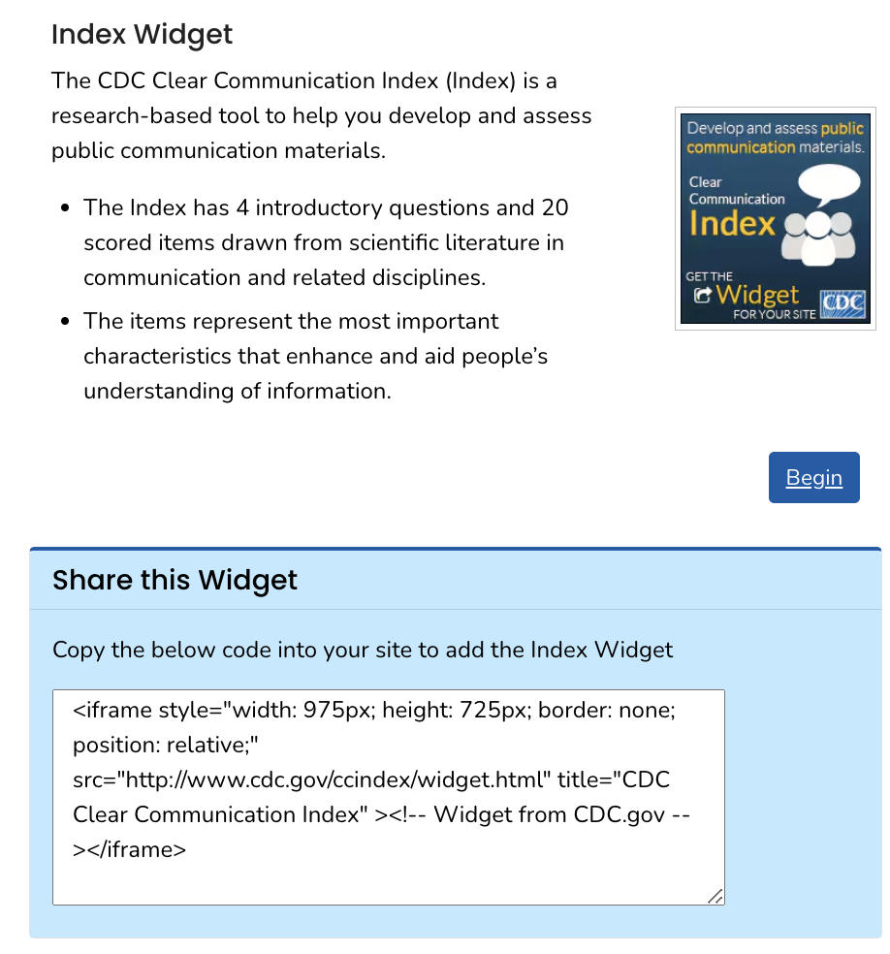
CDC Tools: Clear Communication Index (Widget Focused on Health Literacy)
9
Link: https://www.cdc.gov/ccindex/index.html
Notes:
https://www.cdc.gov/ccindex/

Slide 40
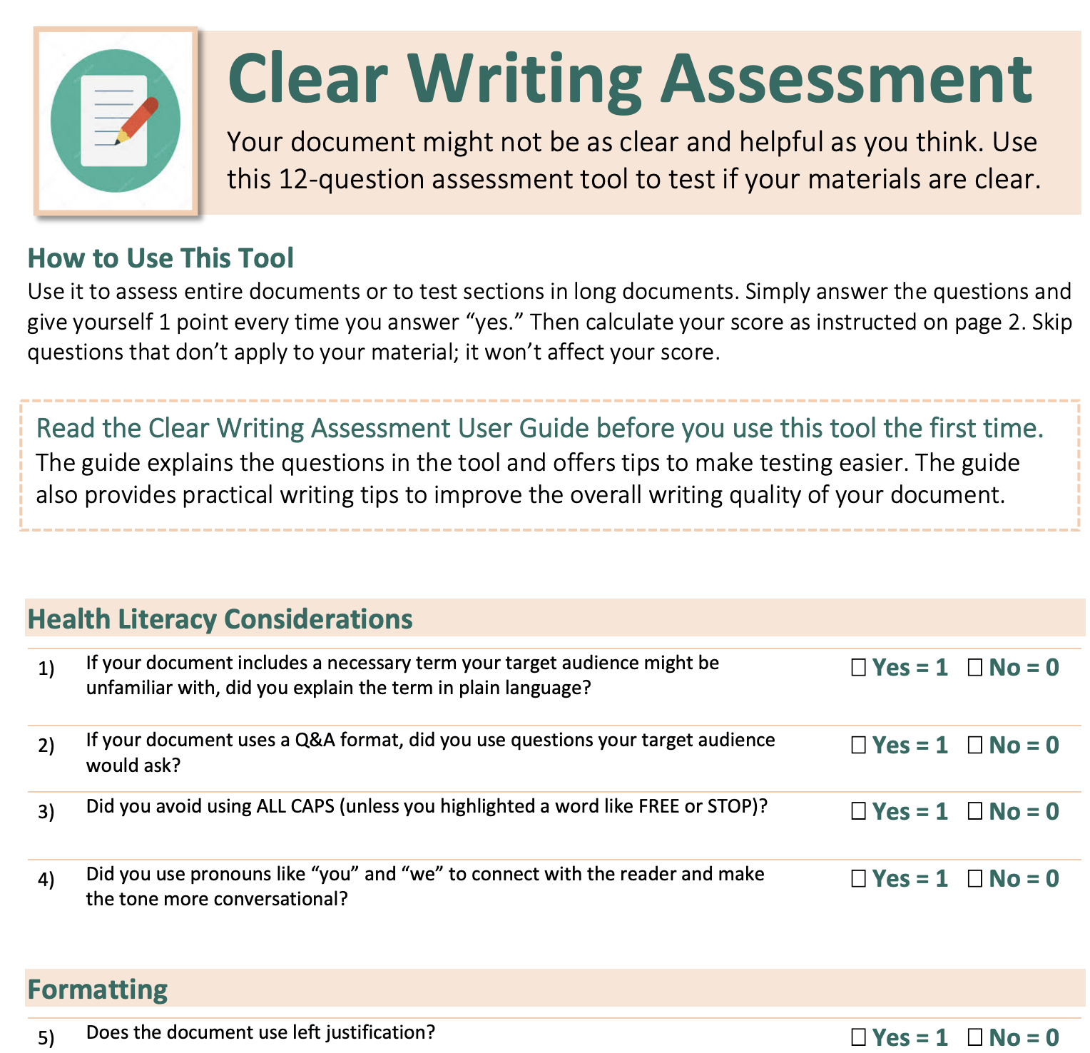
CDC Tools: Clear Writing Assessment (Focused on Plain Language)
10
Link: https://www.cdc.gov/nceh/clearwriting/docs/Clear_Writing_Assessment-508.pdf
Notes:
https://www.cdc.gov/ccindex/

Slide 41
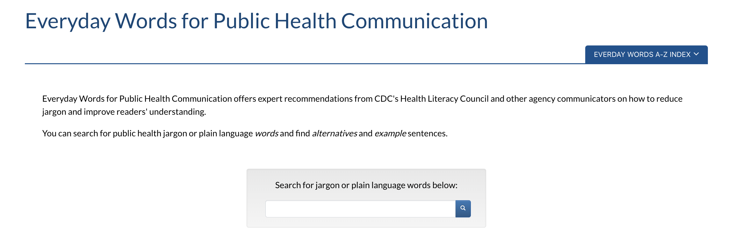
CDC Tools: Everyday Words
11
Link: https://www.cdc.gov/ccindex/everydaywords/index.html
Notes:
https://www.cdc.gov/ccindex/everydaywords/index.html

Slide 42
Questions/Discussion

Slide 43



Stay Connected With NPIN
Subscribe to
NPIN NEWS
@CDCNPIN
CDC NPIN

