Slide 1
How to Build Impactful Connections with Diverse Communities

Slide 2
Introduction
Pearl Owen
Managing Director
Strategic Planning
Dino Hainline
Senior Strategist
Strategic Planning

Slide 3
Goals For Today
Understand the importance of culture in healthcare communication
Understand how culture and intersectionality can impact health views
Learn about cultural competence and cultural humility
Discuss best practices in creating culturally impactful communication
Walk through an example (under limited time and budget constraints)
Watch a case study (with more ample budget and time)
Make connections with fellow participants for future collaboration

Slide 4
Who is this Course for: EVERYONE
Level of experience in creating outreach material to diverse communities
Less
experience
Deep
experience
We acknowledge that some of you may have more or less experience in this topic and hope that this is either a reminder/refresher tutorial that compliments your expertise or a good foundation for continued learning.

Slide 5
Understanding the Importance of Cultural Diversity

Slide 6
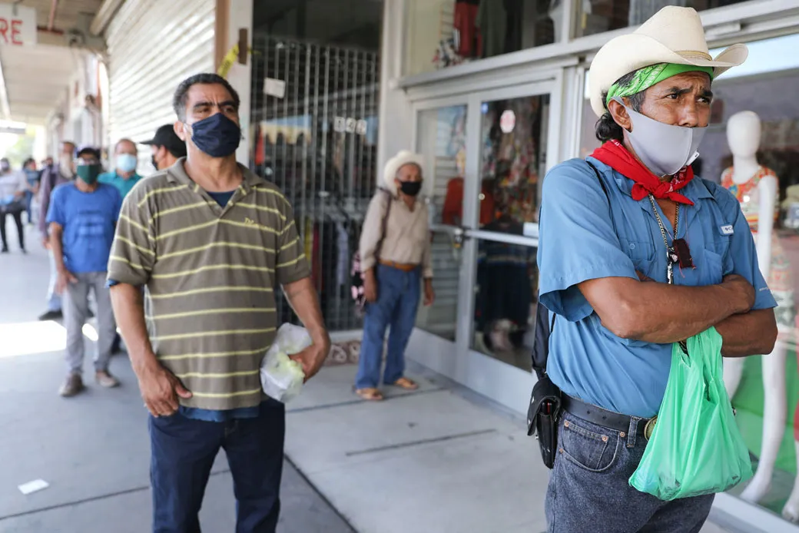
Lack of Cultural Connection Can Impede Healthcare
"...growing diversity among patients increases the likelihood that differences between patients and providers will lead to diagnostic errors; missed opportunities for screening; failure to take into account differing responses to medication; harmful drug interactions resulting from simultaneous use of conventional and traditional folk medications; and inadequate patient adherence to clinician recommendations on prescriptions, self-care, and follow-up visits."
https://www.ncbi.nlm.nih.gov/pmc/articles/PMC5094358/
Notes:
https://www.ncbi.nlm.nih.gov/pmc/articles/PMC5094358/
https://targethiv.org/library/topics/cultural-competency

Slide 7
Culturally Connected Communication Can Improve Care
"People who feel understood, respected, and valued are more likely to stay in care."
https://targethiv.org/library/topics/cultural-competency
Notes:
https://www.ncbi.nlm.nih.gov/pmc/articles/PMC5094358/
https://targethiv.org/library/topics/cultural-competency

Slide 8
A Look at Diverse Communities: Disparities in HIV
Notes:
https://www.cdc.gov/hiv/data-research/facts-stats/race-ethnicity.html#:~:text=While%20HIV%20affects%20all%20races,estimated%20HIV%20infections%20in%202021.
https://www.cdc.gov/tb/statistics/reports/2022/demographics.htm#:~:text=During%202022%2C%20persons%20with%20TB,African%20American%20persons%20(15.8%25)
https://www.cdc.gov/std/statistics/2022/figures/syph-1.htm
https://www.cdc.gov/hepatitis/statistics/2021surveillance/hepatitis-c/figure-3.6.htm
https://www.ncbi.nlm.nih.gov/pmc/articles/PMC10485990/

Slide 9
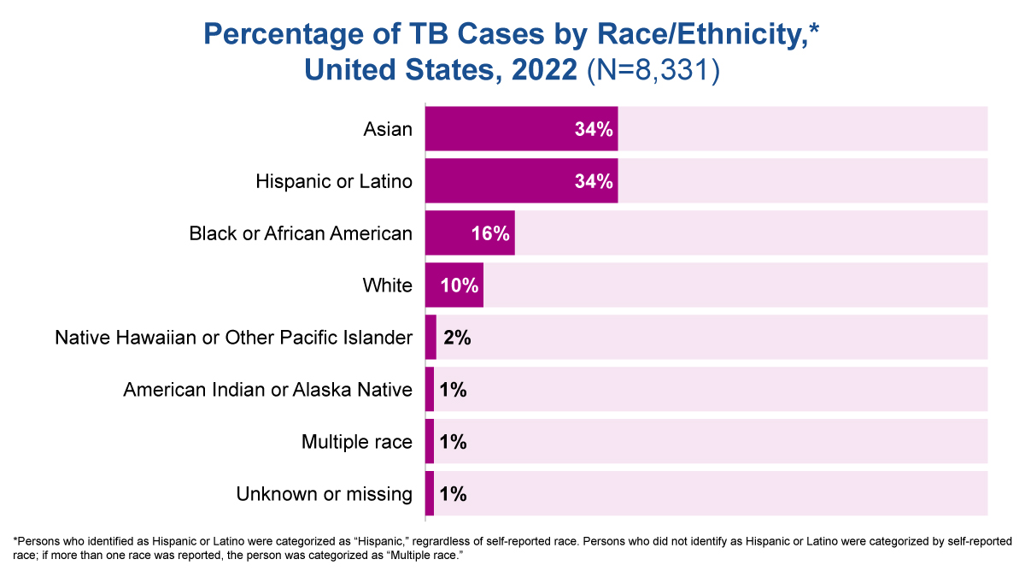
A Look at Diverse Communities: Disparities in Tuberculosis
Notes:
https://www.cdc.gov/hiv/data-research/facts-stats/race-ethnicity.html#:~:text=While%20HIV%20affects%20all%20races,estimated%20HIV%20infections%20in%202021.
https://www.cdc.gov/tb/statistics/reports/2022/demographics.htm#:~:text=During%202022%2C%20persons%20with%20TB,African%20American%20persons%20(15.8%25)
https://www.cdc.gov/std/statistics/2022/figures/syph-1.htm
https://www.cdc.gov/hepatitis/statistics/2021surveillance/hepatitis-c/figure-3.6.htm
https://www.ncbi.nlm.nih.gov/pmc/articles/PMC10485990/

Slide 10
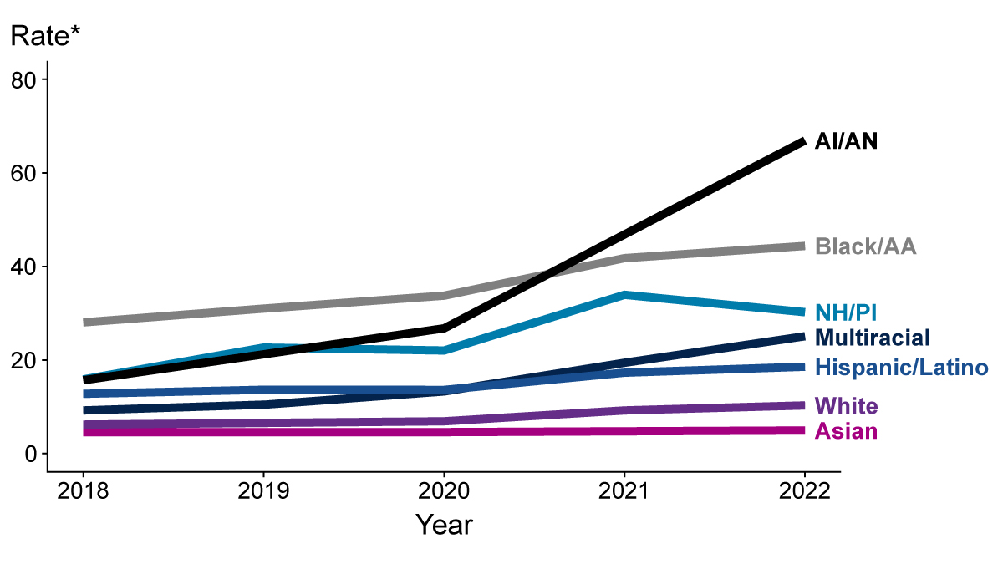
A Look at Diverse Communities: STIs/Syphilis
Notes:
https://www.cdc.gov/hiv/data-research/facts-stats/race-ethnicity.html#:~:text=While%20HIV%20affects%20all%20races,estimated%20HIV%20infections%20in%202021.
https://www.cdc.gov/tb/statistics/reports/2022/demographics.htm#:~:text=During%202022%2C%20persons%20with%20TB,African%20American%20persons%20(15.8%25)
https://www.cdc.gov/std/statistics/2022/figures/syph-1.htm
https://www.cdc.gov/hepatitis/statistics/2021surveillance/hepatitis-c/figure-3.6.htm
https://www.ncbi.nlm.nih.gov/pmc/articles/PMC10485990/

Slide 11
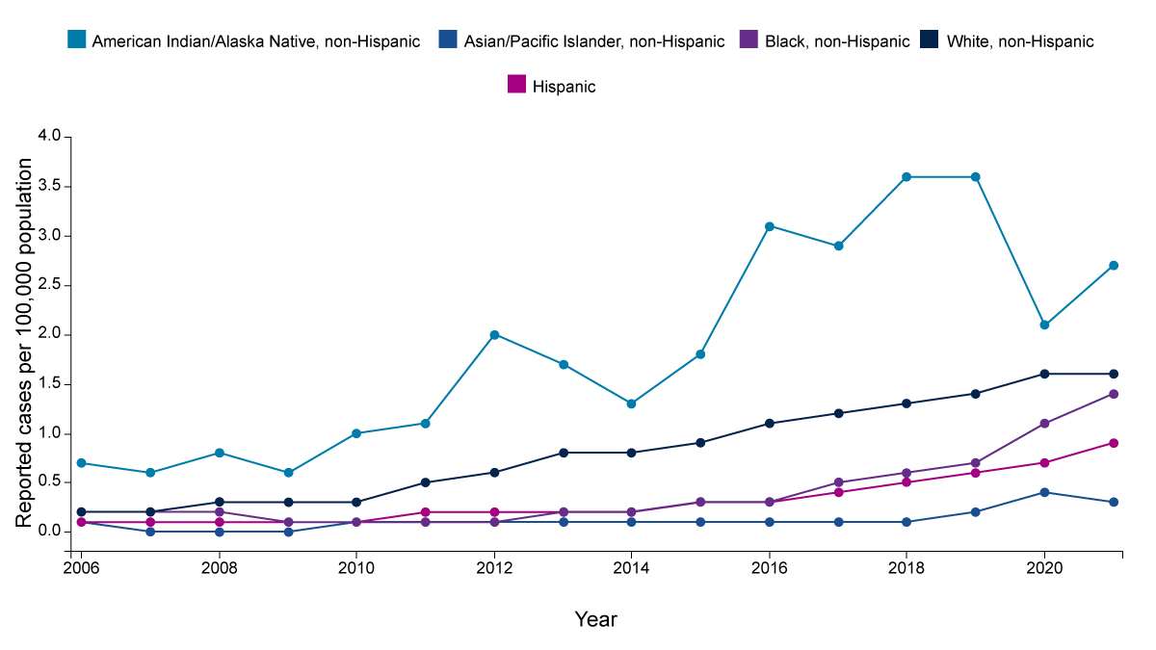
A Look at Diverse Communities: Disparities in Hepatitis
Notes:
https://www.cdc.gov/hiv/data-research/facts-stats/race-ethnicity.html#:~:text=While%20HIV%20affects%20all%20races,estimated%20HIV%20infections%20in%202021.
https://www.cdc.gov/tb/statistics/reports/2022/demographics.htm#:~:text=During%202022%2C%20persons%20with%20TB,African%20American%20persons%20(15.8%25)
https://www.cdc.gov/std/statistics/2022/figures/syph-1.htm
https://www.cdc.gov/hepatitis/statistics/2021surveillance/hepatitis-c/figure-3.6.htm
https://www.ncbi.nlm.nih.gov/pmc/articles/PMC10485990/

Slide 12
Defining Culture
Culture can be defined by group membership or by beliefs:
Group Membership:
Racial, ethnic, linguistic, or geographical groups.
Beliefs:
Values, customs, ways of thinking, communicating, and behaving specific to
a group.
Remember that culture is not limited to religious, racial, or ethnic groups.
For example, the Deaf and LGBTQIA+ communities have distinct cultures.
https://www.cdc.gov/healthliteracy/culture.html
https://www.ahrq.gov/health-literacy/improve/precautions/tool10.html

Slide 13
Defining Cultural Relationships: Moments that Impact Healthcare
Relationship with Self
Relationship with Community
Relationship with Health
Cultural Relationships
Relationship with Resources
Relationship with Authority

Slide 14
Intersectionality: Multidimensional Identities
Notes:
A woman who is Black, bisexual, and expecting her first child has at least three layers or dimensions of diversity (her pregnancy could count as a fourth dimension since it’s a form of temporary disability), and the intersection of these identities makes up her lived experience.
There are also times when this same person will be discriminated against for being a woman, being Black, being pregnant, being bisexual or all four factors at the same time.
https://www.osmosis.org/blog/2023/08/22/what-is-intersectional-healthcare-and-why-is-it-important

Slide 15
Building Impactful Connections with Diverse Cultures

Slide 16
Cultural Competence vs Cultural Humility
We are shifting away from an ideal of "competence" and moving into an ideal of "humility":
Cultural competence is well established in the medical and public health lexicon.
“Seeking cultural competence can contribute to the reproduction of social stereotypes and an imbalance of power between patients and providers.”
Cultural humility is based on self-reflexivity, appreciation of patients' expertise on their social
and cultural context, openness to establishing
power-balanced relationships with patients, and
a lifelong dedication to learning.
Cultural humility means admitting that one
does not know and is willing to learn from patients about their experiences.
“While competence suggests mastery, humility refers to an intrapersonal and interpersonal approach that cultivates person-centered care.”
https://www.ncbi.nlm.nih.gov/pmc/articles/PMC7756036/

Slide 17
Identify Cultural Impact Zones for Your Communication
Audience's cultural world
Health context and need for communication
Cultural Impact Zone

Slide 18
How to Create Impactful Communications
STEP 1
STEP 2
STEP 3
STEP 4
STEP 5
Define the special health message you need to communicate
Define your audience community
Identify special cultural considerations
Create content informed by your research
Get feedback
on your communication

Slide 19
Goal: HIV Testing Material
CHALLENGE:
Create culturally impactful communication that would encourage HIV/AIDS testing among those most likely to be at risk
ASSUMPTIONS:
Limited time and budget
(no ability to conduct formal research)

Slide 20
Step 1: Define Special Health Message/Find Sources
CATEGORY | EXAMPLES
National or state health agency | Center for Disease Control (CDC) National Prevention Information Network (NPIN) Office of Minority Health (OMH) HIV.gov National Institute of Health (NIH) Health Resources & Services Administration Ryan White HIV/AIDS Progam (HRSA)
Well-recognized organizations | Kaiser Family Foundation (KFF) AIDSVu
Health studies/reports | Pub Med

Slide 21
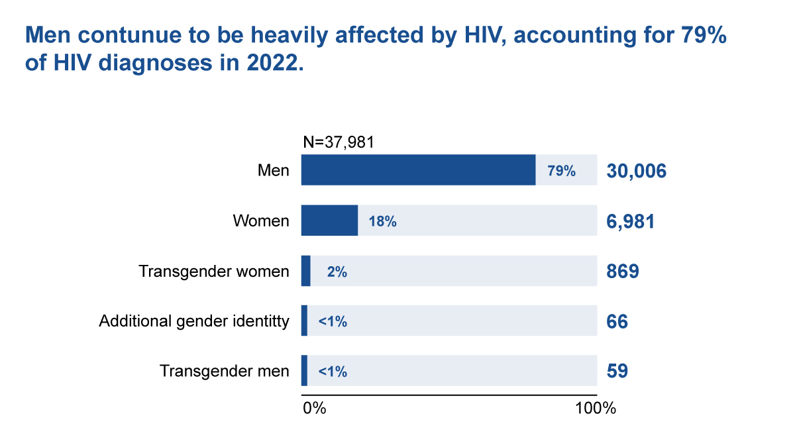
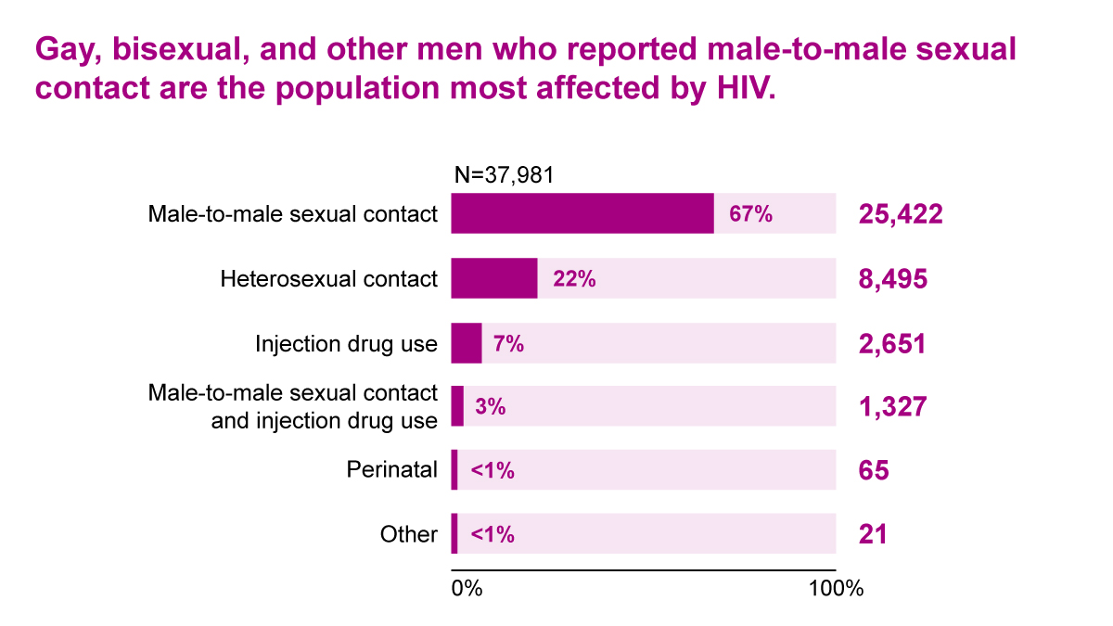
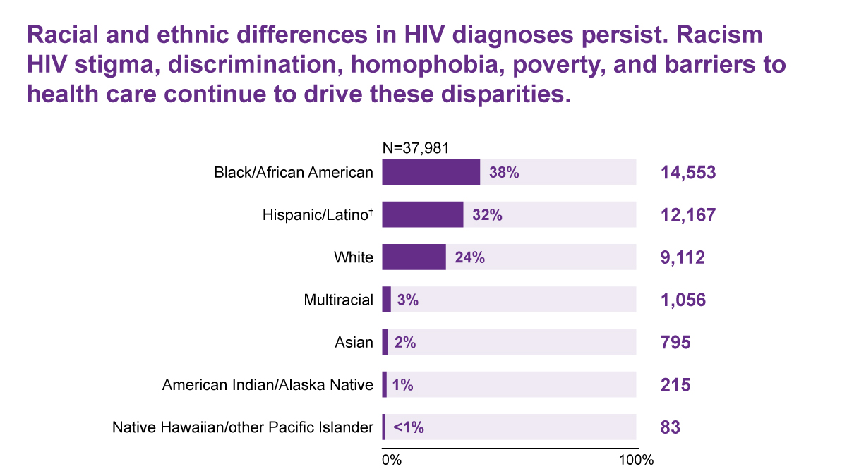
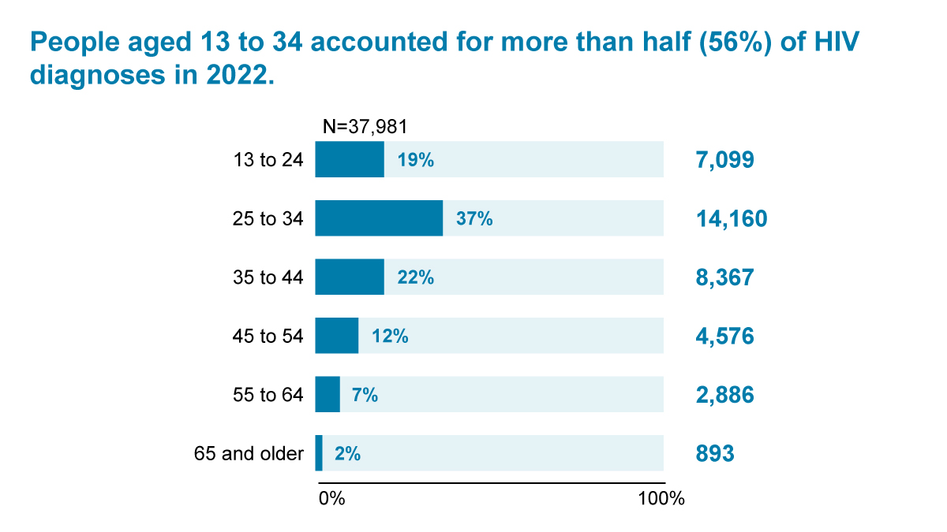
Step 2: Define Your Audience
Notes:
https://www.cdc.gov/hiv-data/nhss/hiv-diagnoses-deaths-prevalence.html#:~:text=Men%20are%20most%20affected%2C%20making,those%20aged%2013%20to%2034.

Slide 22
Step 2: Define Your Audience
79%
of diagnosis are men
67%
of transmission is
male-to-male contact (gay, bisexual and
other MSM)
38%
Black/AA
32%
Hispanic/Latino
56%
Age 13-34
Audience
Young African American MSM (Intersectional Audience)

Slide 23
Step 3: Identify Cultural Considerations/Refine Sources
No community is a monolith. You will have to clarify your focus and make tradeoffs.
CATEGORY | EXAMPLES
African American Men's health studies, reports, orgs | Black Men's Health Clinic Black Men's Health Initiative NIH: Visible and Invisible Trends in Black Men's Health John's Hopkins: Black Men's Health Project
African American MSM health studies, reports, orgs | JMIR: Implementation of Evidence-Informed Behavioral Health Models to Improve HIV Health Outcomes for Black Men Who Have Sex With Men Columbia: PrEP for Black MSM Community-Based Ethnography and Clinic-Based Treatment
African American HIV/AIDS studies, reports orgs | TargetHIV.org Ryan White HIV Care Black/African American TargetHIV.org Best Practices Compilations Black AIDS Institute AIDS Project Los Angeles

Slide 24
Step 3: Identify Cultural Considerations/Reach Out to Stakeholder
Even 30 minutes with an expert can be enriching.
 | Identify someone in the field who may be willing to talk with you
 | Someone from your audience group Possibly a volunteer at a health organization that has personal experience to share
 | A "proxy" interview Someone who works with your audience group on a regular basis and can share their personal experiences and observations

Slide 25
Step 3: Identify Cultural Considerations/Reach Out to Stakeholder
Black AIDS Institute (BAI) is dedicated to ending the HIV/AIDS epidemic in the Black community. BAI is the only uniquely and unapologetically Black HIV think and do tank in America. We believe in complete freedom for Black people by eradicating systematic oppression so that we can live long, healthy lives.
KEY LEARNINGS
Integrate trauma-informed care into all HIV services
Integrate harm reduction into all HIV services
Integrate self-care and mental health into all HIV services
Develop engagement strategies for
key Black subpopulations
Integrate peer recovery coaching, peer mentors, community clubhouses and other people-centered approaches for people living with HIV
https://blackaids.org/wp-content/uploads/2021/02/Black-AIDS-Institute-We-The-People-Report-2020-Version-1.1.pdf

Slide 26
Step 4: Create Content Informed by Your Research
RESEARCH FINDINGS
Persistent racism in all environments
Distrust of healthcare system
Barriers to
healthcare access
(insurance; primary provider)
Persistent stigma around HIV/AIDS
(social connections at risk)
Privacy is important
Desire to embrace
the positive
(focus more on treatments, solutions, paths forward vs fear, despair)

Slide 27
Step 4: Create Content Informed by Your Research – Bringing it Together
Health Need
Audience
Encourage testing: Testing allows for early intervention and treatment as well as may reduce the risk of infecting a partner
Young AA MSM: Facing racism and stigma; unsupported in medical community; distrusting of healthcare system; looking for a focus on positive possibilities
Cultural Impact Zone:
Aligning these two areas of focus will create opportunities for meaningful communication.

Slide 28
Step 4: Create Content Informed by Your Research – Content Zones
Possibilities
Honoring Self
Community Care

Slide 29
Step 5: Get Feedback on Your Communication
Ensure you are looking at all angles
Gut check with internal staff
Gut check with
a partner, trusted
ally in the audience community

Slide 30
Case Study: Text Me, Girl

Slide 31
Text Me, Girl Considerations
Guided by science/research
Founded on audience insights
Co-created

Slide 32
Questions?

Slide 33
Thank you!

